Slide 1
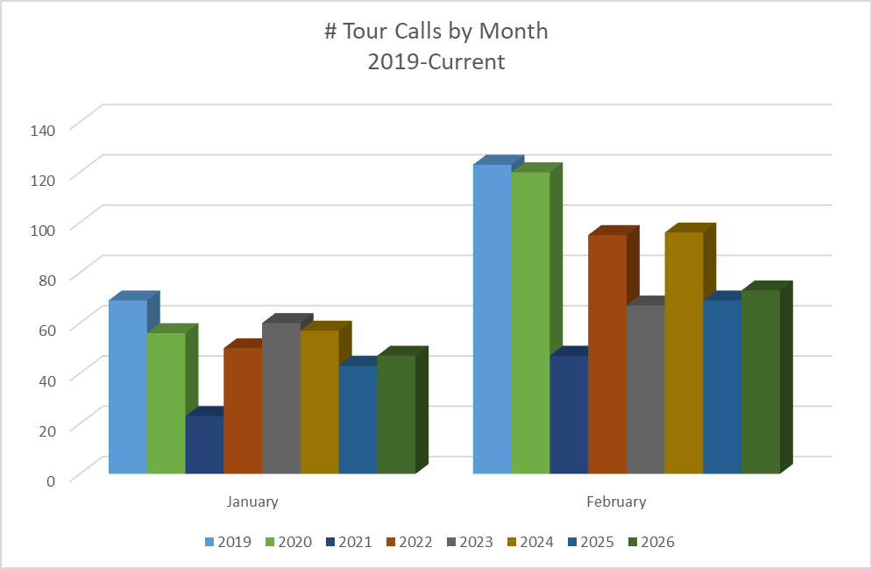
3/19/2020 – Notice issued that Phone Reservations suspended due to COVID-19 pandemic
5/21/2020 – Office Phone Reservations resume

Slide 2
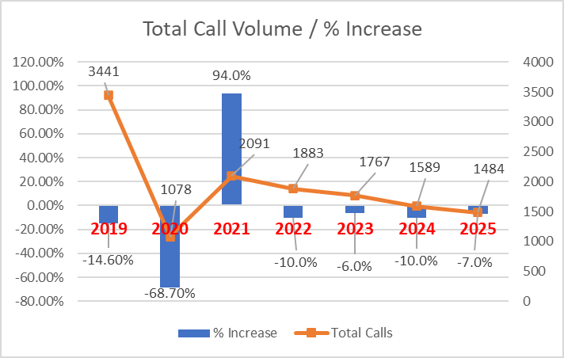
ANNUAL Trend

